Slide 1
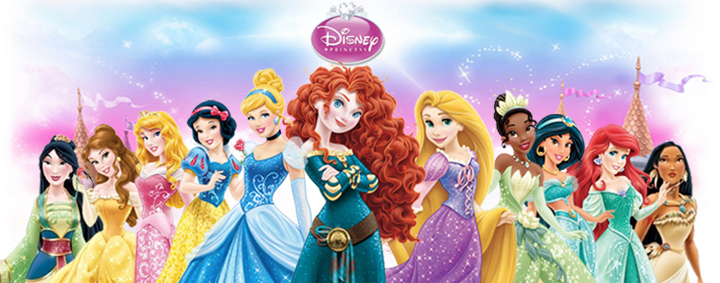
A Quantitative Analysis of Gendered Compliments in Disney Princess Films
Carmen Fought, Pitzer College
Karen Eisenhauer, North Carolina State University

Slide 2
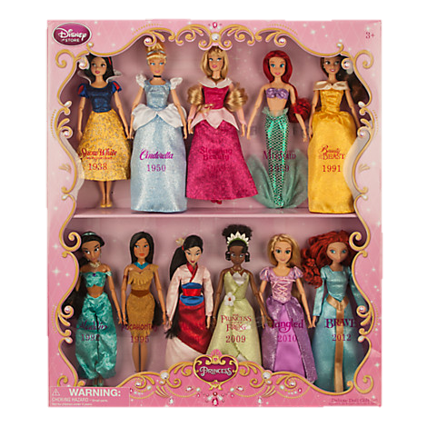
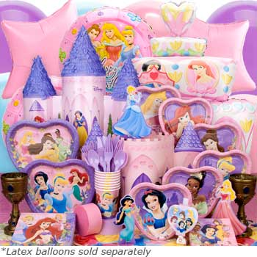
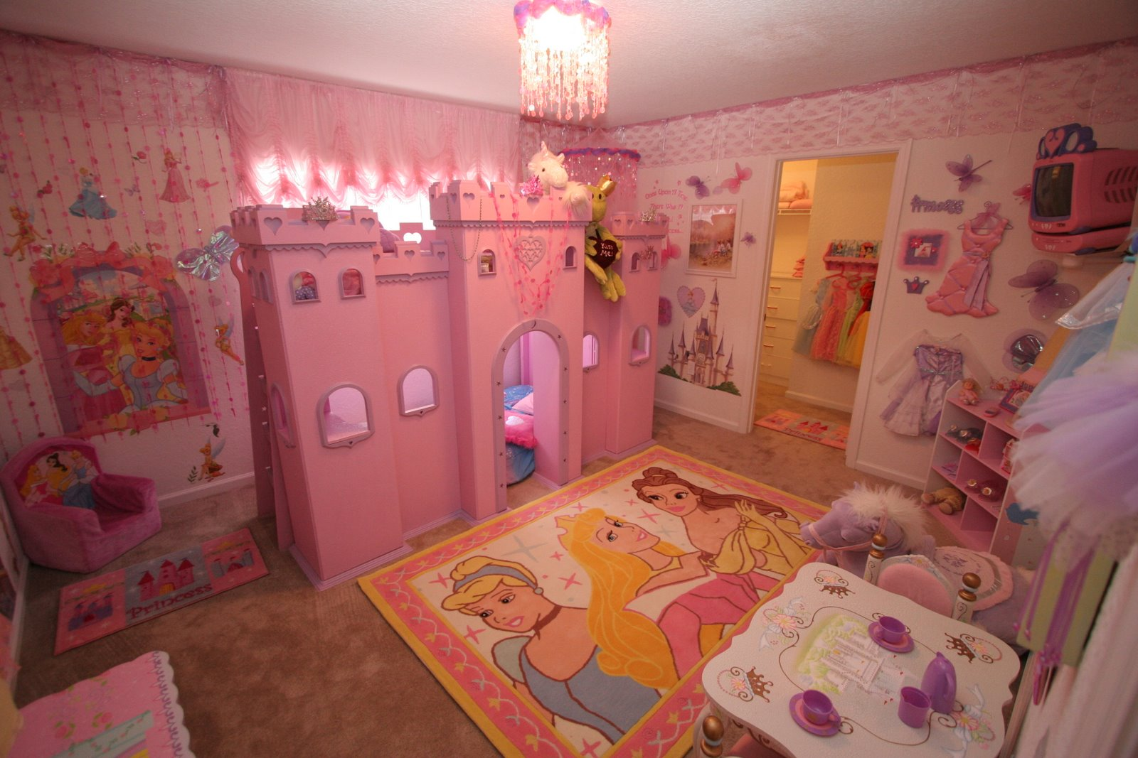
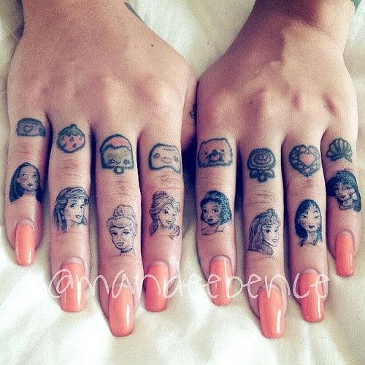
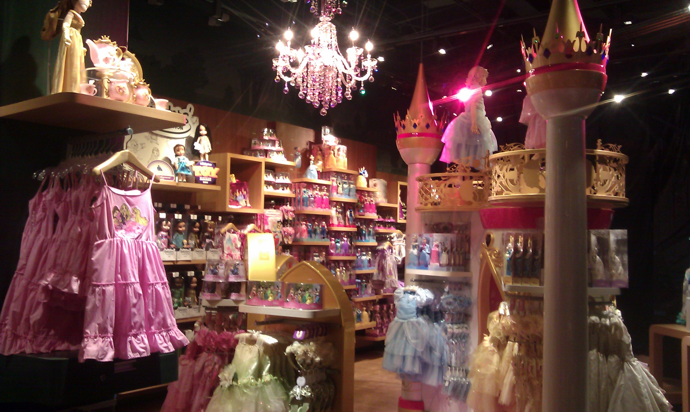
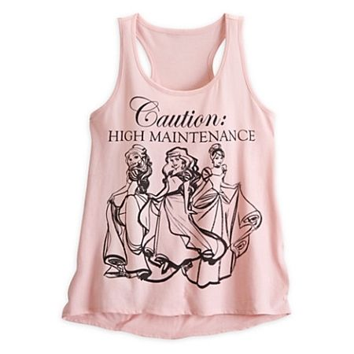

Slide 3
The perils of qualitative research…
“…Ariel and Jasmine, who choose to marry their heroes, do so not simply to obtain husbands, but as an exercise of their regal prerogative, irrevocably changing the status quo by choosing a consort contrary to accepted norms.’ (Do Rozario 2004)
“The film initially posits Ariel’s fascination with land as cause for leaving the ocean, but in the style of backlash politics, it eventually channels her struggle for independence and autonomy into the more traditional, narrow goal of choosing a husband. The narrative commandeers her desire into a desperate teenage romance; (Stover 2013)

Slide 4
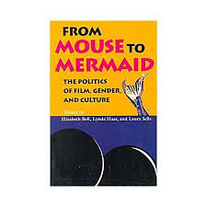
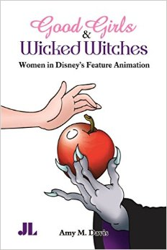
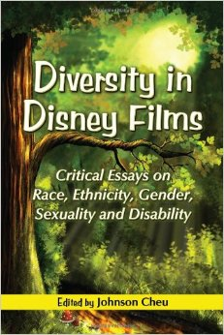
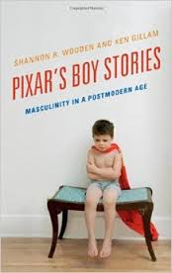
Why Disney?
“Animated films appear to inspire at least as much cultural authority… for teaching specific roles, values, and ideals as do more traditional sites of learning (Giroux, 1999)
Disney Princess Franchise
Founded in 1990s, currently has 13 princesses and $4 billion net worth

Slide 5
In what ways do Disney Princess films use language to characterize gender differences?

Slide 6
How do the films’ linguistic depictions of gender compare to gendered patterns of speech in real communities?

Slide 7
Has there been any change in how gender and language are portrayed in Disney films over time?

Slide 8
Three Princess Eras
Classics Era 1937-1959 | Snow White | 1937
 | Cinderella | 1950
 | Sleeping Beauty | 1959
Renaissance Era 1989-1999 | The Little Mermaid | 1989
 | Beauty and the Beast | 1991
 | Aladdin | 1992
 | Pocahontas | 1995
 | Mulan | 1997
New Age Era 2009 - | Princess and the Frog | 2009
 | Tangled | 2010
 | Brave (Pixar) | 2012
 | Frozen | 2013

Slide 9
Gender in Disney
Gender is generally portrayed as binary, uncomplicated, heteronormative
All films except Aladdin star women, but they are populated overwhelmingly by male characters

Slide 13
Compliments
“A speech act which explicitly or implicitly attributes credit to someone other than the speaker, usually the person addressed, for some ‘good’ (possession, characteristic, skill, etc.) which is positively valued by the speaker and the hearer” (Holmes 1986)
Types of compliments
Appearance “She’s mighty Pretty. She’s beautiful!” (Dwarves, Snow White)
Ability, Performance, or Skill “You….. You fight good.” (Shang, Mulan)
Possessions “This is quite a remarkable device.” (Sultan, Aladdin)
Personality, Friendliness “He’s really kind and gentle…. He’s my friend.” (Belle, Beauty and the Beast)
General, Other “Some people are worth melting for.” (Olaf, Frozen)
Foundational studies: Wolfson (1983), Holmes (1986, 1998) Parisi & Wogan (2006), Rees-Miller (2011)

Slide 14
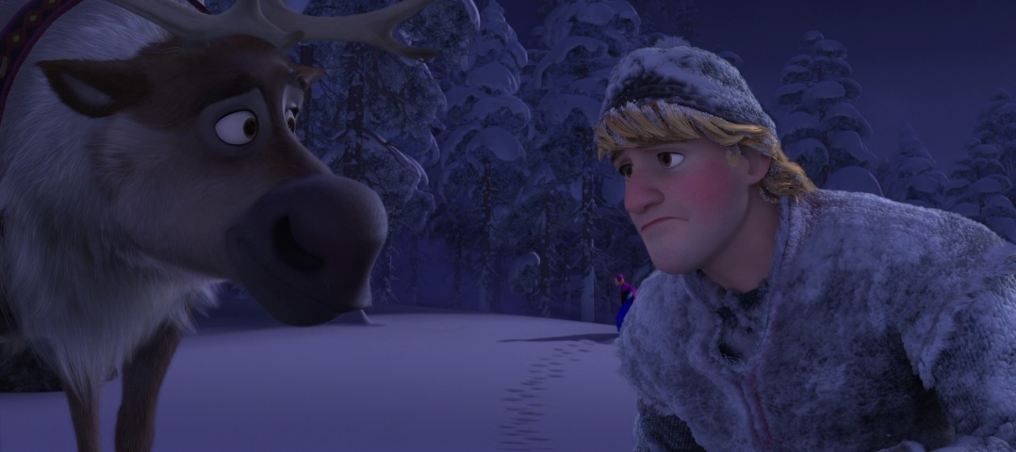
Methodology
Compliments pulled from script (Songs excluded), along with gender of speaker and recipient
Edited by second coder, conflicts resolved
“Weeded” controversial compliments by third coder, conflicts resolved
Edge cases excluded

Slide 15
Results
 | Male Giver | Female Giver | Male receiver | Female receiver | TOTAL
Holmes (1986) | 32% (n=155) | 68% (n=329) | 26% (n=126) | 74% (n=358) | n = 484
Parisi et al. (2006) | 29% (n=65) | 71% (n=158) | 30% (n=68) | 70% (n=155) | n = 223
Our Results | 67% * (n=244) | 33% * (n=122) | 54% ** (n=197) | 46%** (n=169) | n = 366
* p<0.001
** n.s.

Slide 16
Comparison with Parisi & Wogan 2006
(From Parisi & Wogan 2006)
TOPIC | Female-Male | Male-Female | Male-Male | Female-Female
Appearance* | 25% (18) | 33.61% (40) | 12.8% (16) | 44% (22)
Skill** | 27.78% (20) | 27.73% (33) | 60% (75) | 30% (15)
Possessions | 5.56% (4) | 6.72% (8) | 0.8% (1) | 6% (3)
Personality | 23.61% (17) | 12.61% (15) | 11.2% (14) | 14% (7)
Other | 18.06% (13) | 19.33% (23) | 15.2% (19) | 6% (3)
Total Compliments | 72 | 119 | 125 | 50
* p<0.005 Other categories n.s.
** p<0.001

Slide 17
Are female characters more likely to receive compliments on their appearance than on their skills? (Is this trend reversed for males? Does this change over time?)
Are female characters more likely than males to receive compliments on appearance? Is the trend reversed for skill? Does this change over time?

Slide 18
Results: Appearance vs. Skill

Slide 19
A Closer Look at New Age

Slide 20
Results: Men vs. Women
* p<0.001 *p<0.03 *p<0.001
n.s. *p<0.001 n.s.

Slide 21
Future research
Responses to compliments
Unstructured vs goal-oriented settings
Other discourse features: directives, insults, apologies, questions
Qualitative data: what are compliments used for?
Pixar and the “so many dudes everywhere” effect
Men and masculinities in detail

Slide 22
Thank you!!!!
Carmen Fought: cfought@pitzer.edu
Karen Eisenhauer: kreisenh@ncsu.edu
References available on request

